Slide 1
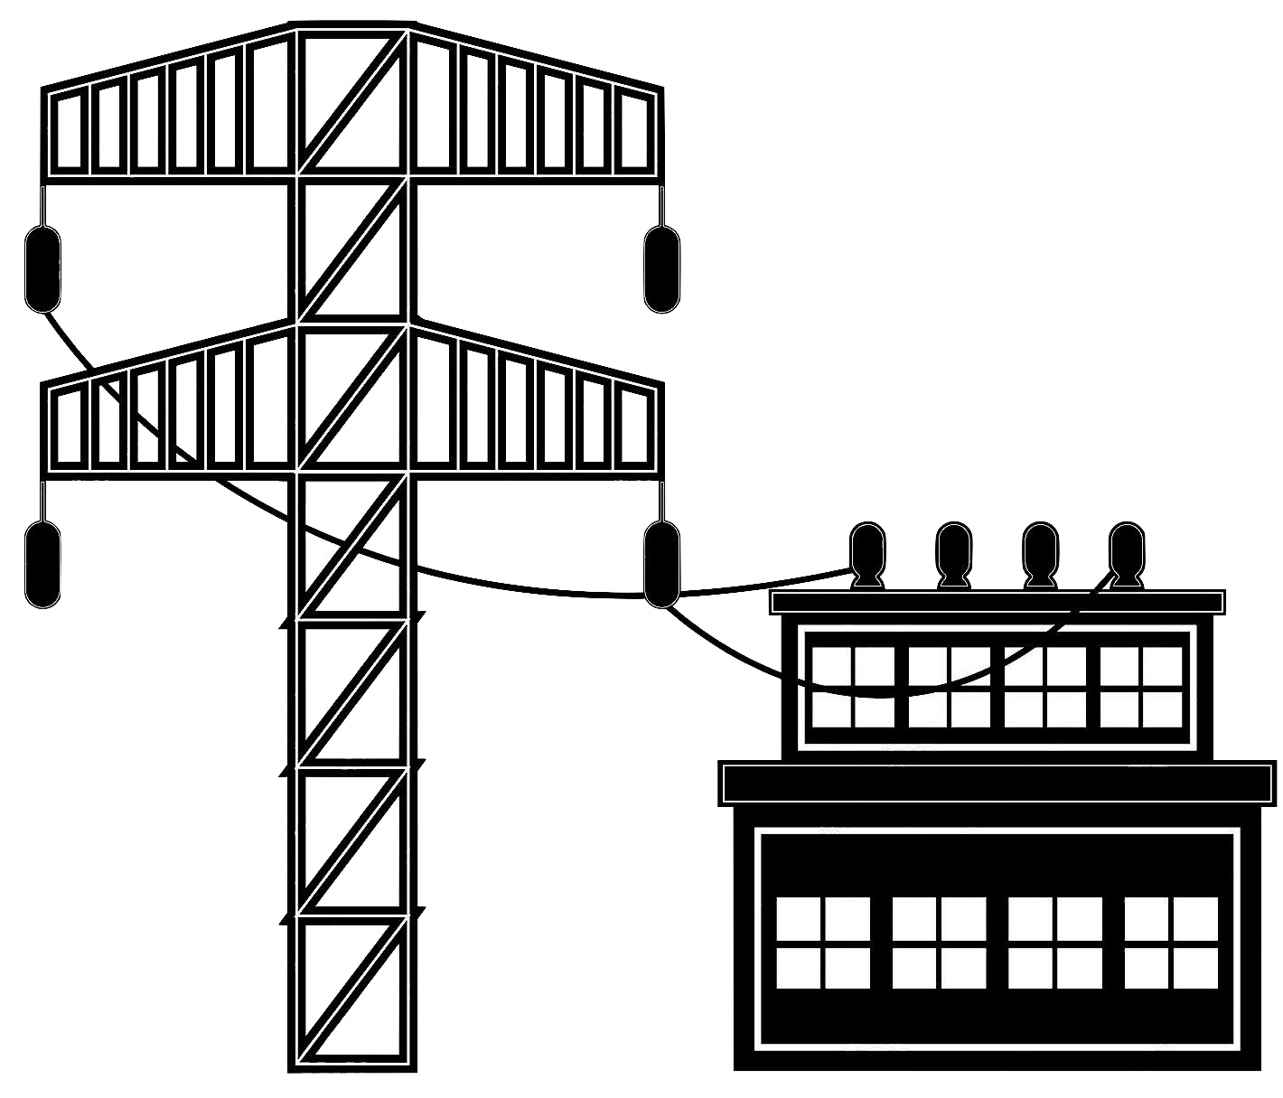
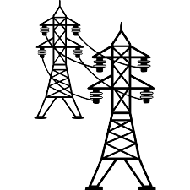





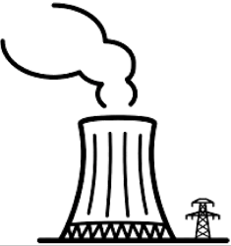

Power Plant Unit (1 GW)
H₂-PPU
6 TWh·y⁻¹
I = 1100 kWh·y⁻¹
Grid
H₂
PV 86 km² or
Wind 1300 x 2 MW
18.9 TWh·y⁻¹
Battery
41 GWh
Grid
Electrolyser
2 GW
Compressor
underground storage
110’000 t(H₂)
1100 t(H₂)·d⁻¹
2 TWh·y⁻¹
Combined cycle
power plant 1 GW
Grid

Slide 2
Power Plant Unit H₂-PPU (1 GW)
Component Database

Slide 3
Power Plant Unit H₂-PPU (1 GW)

Slide 4
Project
Improve the model, utilization in the calculation
Sensitivity analysis, electricity, hydrogen, carbon source
New process pathways, Methanol, Ammonia
Introduce the yield of hydrocarbon synthesis
Cost development e.g. electrolyzers...

